Slide 1
Project-6 Sales Forecasting Across Multiple Retail Stores
Ashish Kumar Sen
Next Hikes IT Solutions

Slide 2
Dataset Overview
Total records: 100,000+ (example)
Columns: Store ID, Sales, Customers, Date, Promo, IsHoliday, IsWeekend
Data granularity: Daily store-level entries

Slide 3
Key Insights from EDA
Sales peak around holidays and weekends.
Promotions significantly boost both sales and customer count.
Some stores consistently underperform.
Strong correlation between store traffic and revenue.

Slide 4
Visual Insights
Sales trend shows seasonal patterns.
Promotions lead to sharp sales spikes.
Customer and Sales curves move together.
High variance across stores.

Slide 5
Recommendations & Next Steps
Deeper analysis justified based on findings.
Proceed with feature engineering and model development.
Include date-derived features (e.g., day of week, month).
Train initial ML model to predict daily sales and customers.

Slide 6
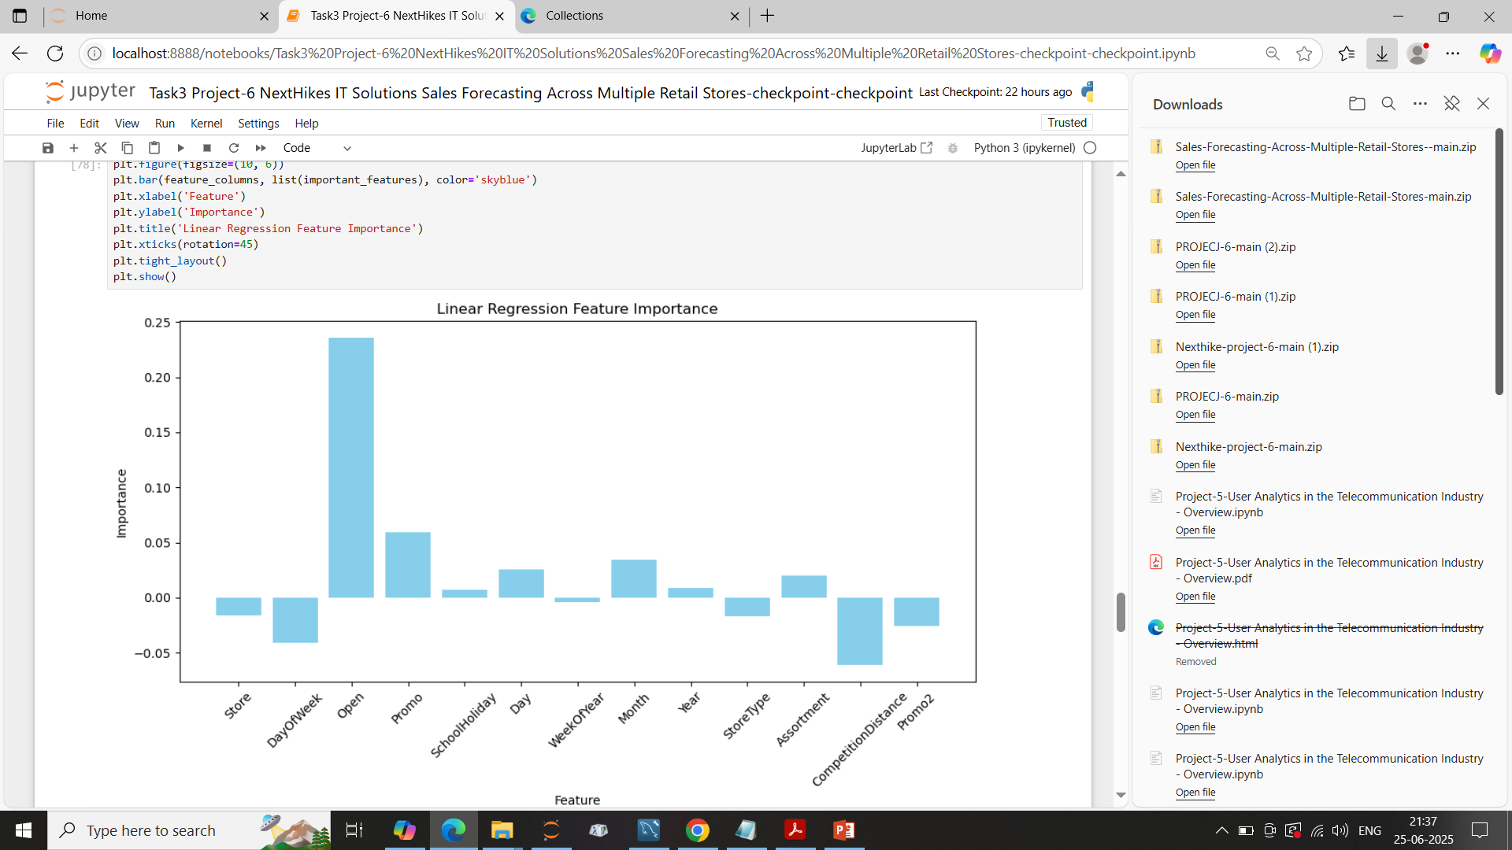
Liner Regression Feature Importance

Slide 7
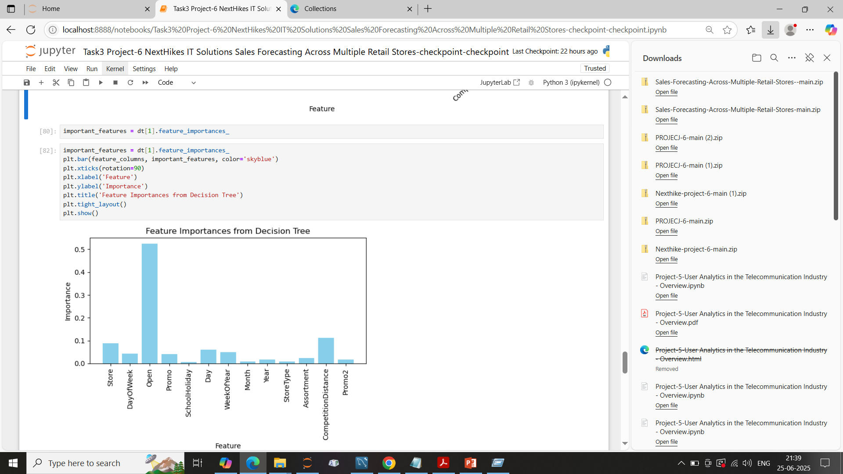
Feature Importance's from Decision Tree

Slide 8
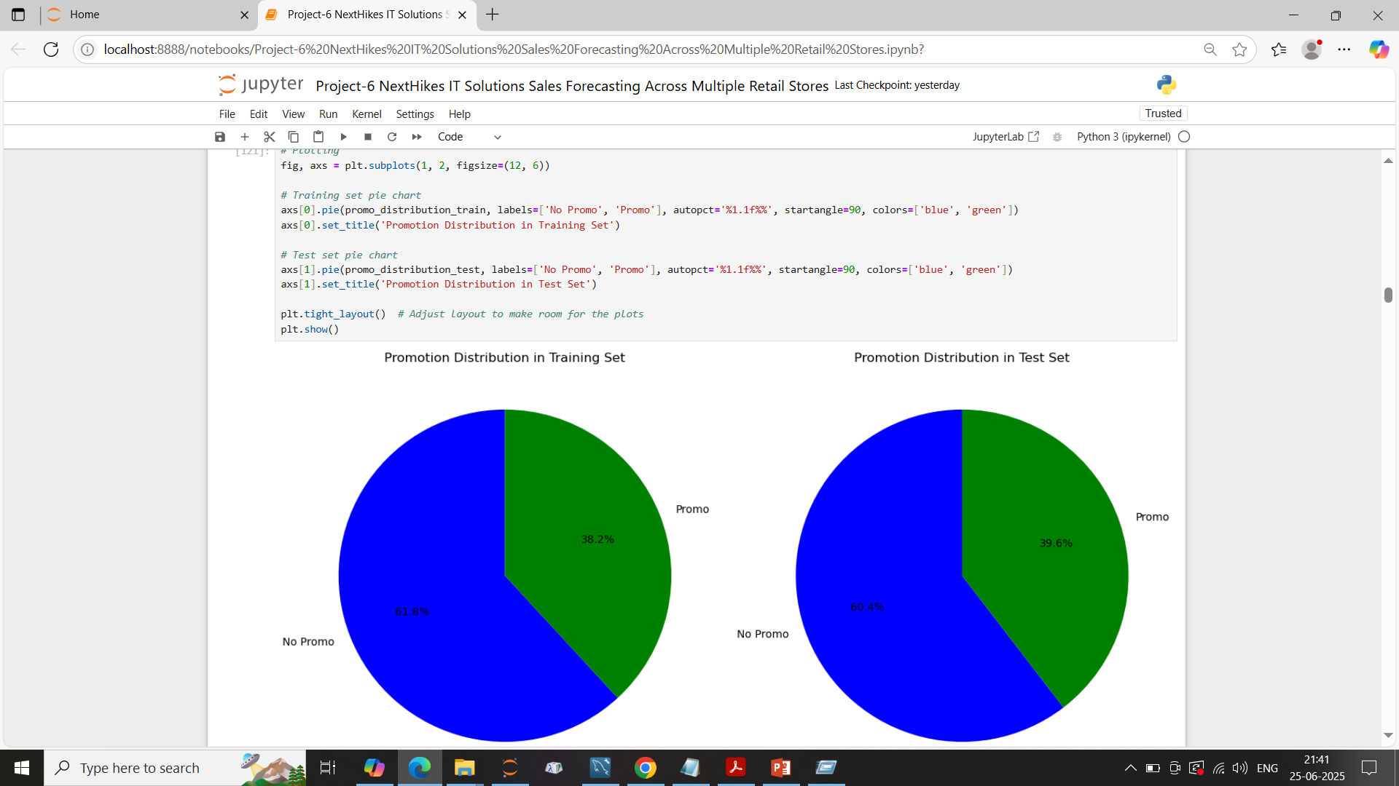
Promotion Distribution in Test Set

Slide 9
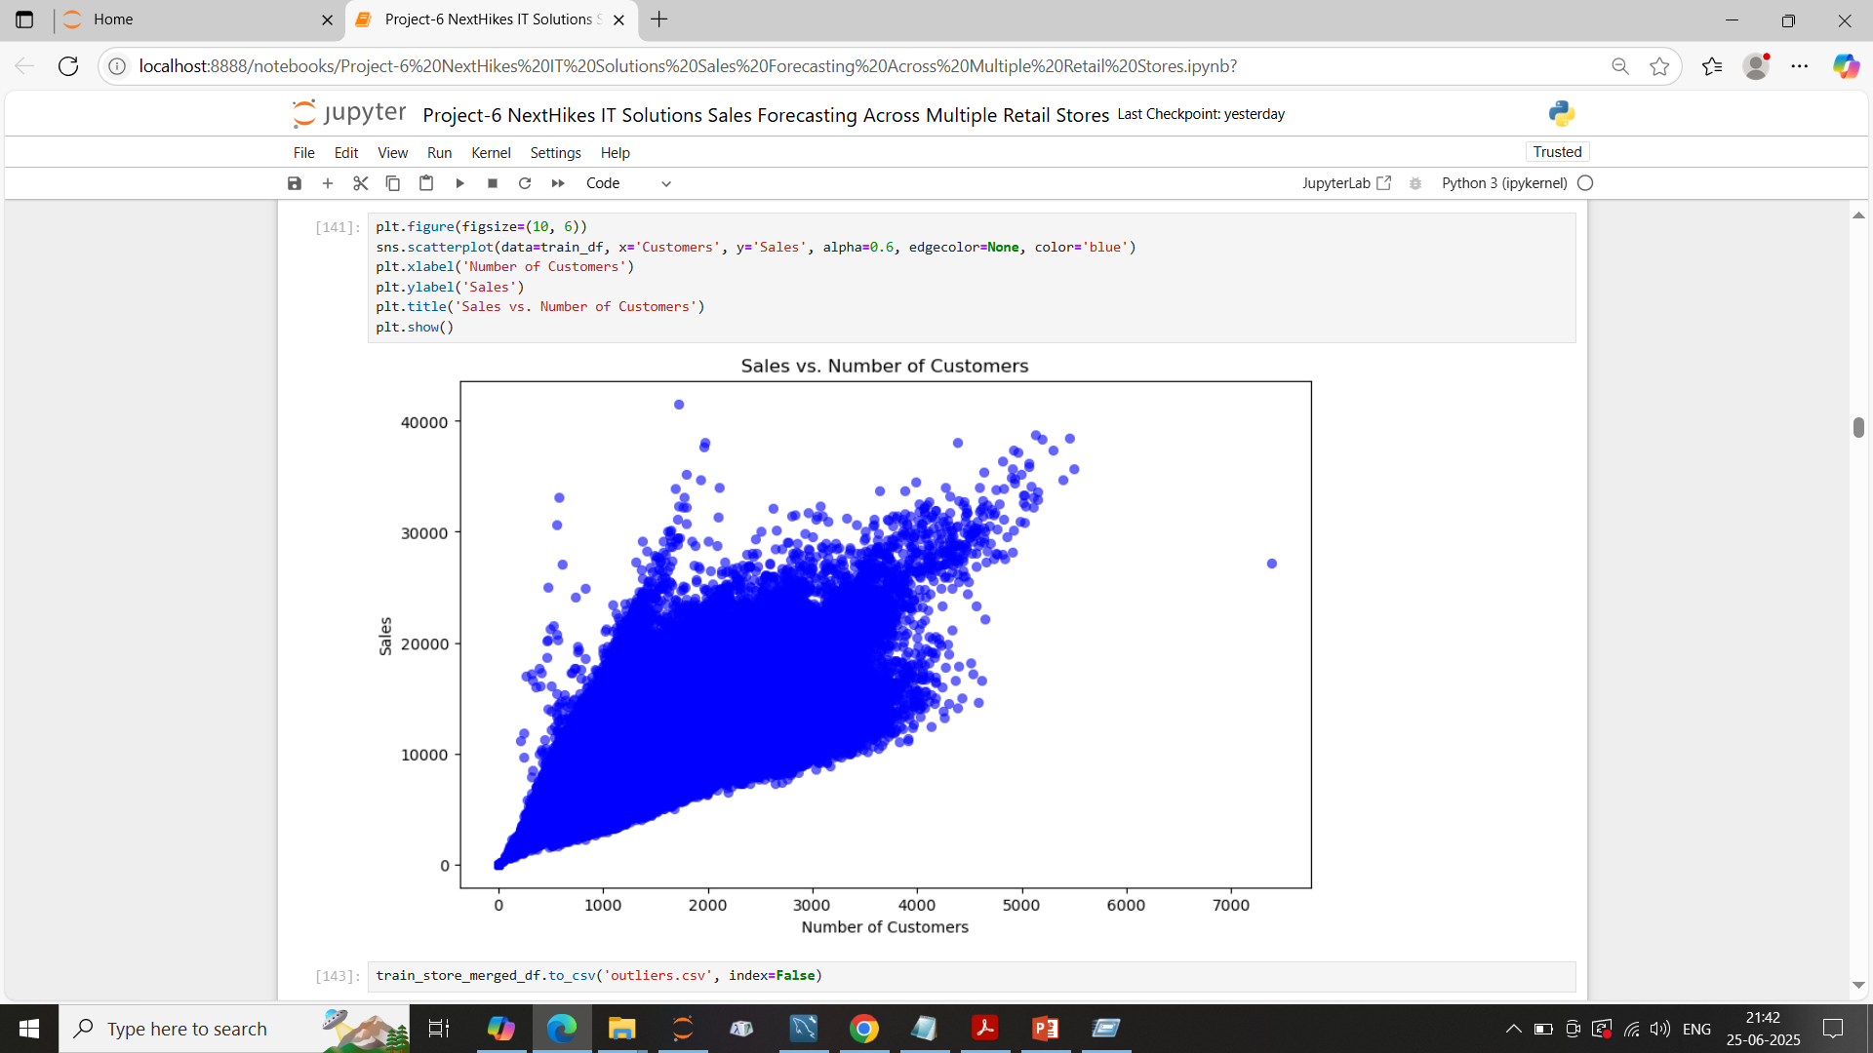
Sales vs. Number of Customers'

Slide 10
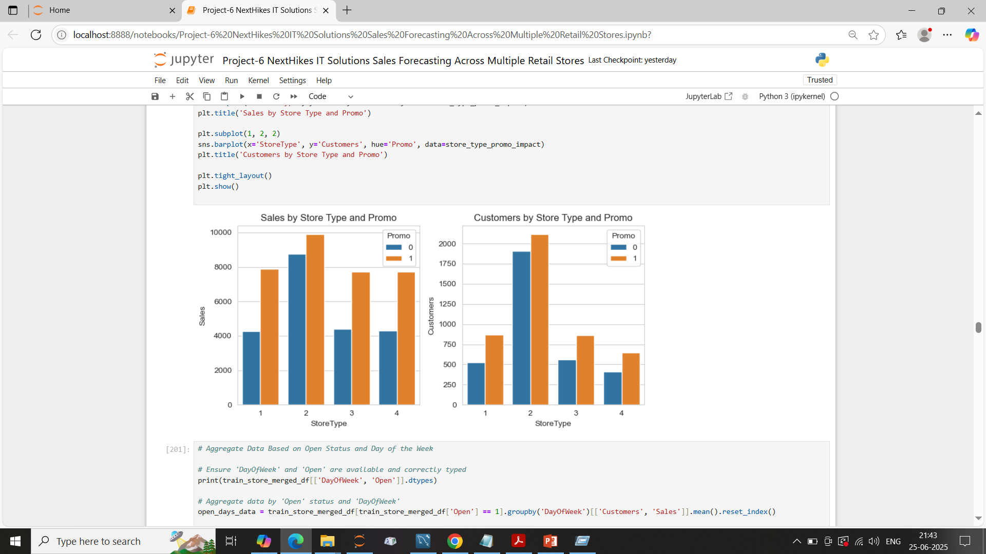
Customers by Store Type and Promo

Slide 11
Thank You

